Slide 1
Children, Youth and Family Discipleship
Pastor Jeremy Mavis
Hayward Wesleyan Church
jeremy@hwcyouth.org jeremymavis.com facebook.com/jdmavis twitter.com/jdmavis instagram.com/jdmavis

Slide 2
Children, Youth and Family Discipleship
Isaiah 6:1-8 NIV
In the year that King Uzziah died, I saw the LORD seated on a throne, high and exalted, and the train of his robe filled the temple. Above him were seraphs, each with six wings: With two wings they covered their faces, with two they covered their feet, and with two they were flying. And they were calling to one another:
“Holy, holy, holy is the LORD Almighty; the whole earth is full of his glory.”
At the sound of their voices the doorposts and thresholds shook and the temple was filled with smoke.
“Woe to me!” I cried. “I am ruined! For I am a man of unclean lips, and I live among a people of unclean lips, and my eyes have seen the King, the LORD Almighty.”
Then one of the seraphs flew to me with a live coal in his hand, which he had taken with tongs from the altar. With it he touched my mouth and said,
“See, this has touched your lips; your guilt is taken away and your sin atoned for.”
Then I heard the voice of the LORD saying,
“Whom shall I send? And who will go for us?”
And I said,
“Here am I. Send me!”

Slide 3
Children, Youth and Family Discipleship
I am researching the impacts that postmodern thought and consumerism have made on the evolution of the family unit. Applying this to children’s ministry, the biblical model of spiritual formation for children occurs primarily within the family unit.
Because of the developments within western culture, however, the traditional family is no longer as common of an environment for children to be reared within.
What is the local church going to need to do in order to serve the needs for the spiritual formation of children in the postmodern era?

Slide 4
Children, Youth and Family Discipleship
Intent of the Family

Slide 5
Children, Youth and Family Discipleship
Formal and Informal Environments

Slide 6
Children, Youth and Family Discipleship
The purpose of the family ministry at HWC is:
to participate, in partnership with the church, in the story God is revealing and weaving in the lives of families as they live and bear witness to the Gospel of Jesus Christ.
The goal of families at HWC is:
to make disciples of Jesus Christ.

Slide 7
Children, Youth and Family Discipleship
Families will participate in God’s story and foster discipleship through:
Faith Teaching
Relational Connections
Spiritual Environments

Slide 8
Children, Youth and Family Discipleship
Choo, Choo Train Model
Church Rail
Wooden Railroad Ties
Family Rail

Slide 9
Children, Youth and Family Discipleship
Church Rail:
Faith Teaching
having a strategic, educational (curricular) plan
Relational Connections
engaging with small group leaders and their peers
Spiritual Environments
participating together in corporate worship

Slide 10
Children, Youth and Family Discipleship
Family Rail:
Faith Teaching
biblical education and Christian life conversations on an informal level (Bible reading, personal stories, prayer, singing, faith conversations)
Relational Connections
engage in Christian community both on the large, whole church worship scale (intergenerational connections), as well as a small group scale (connections with other families and peers).
Spiritual Environments
craft intentional environments that can place your children in the path of the divine (Spiritual Parenting, Michelle Anthony)

Slide 11
Children, Youth and Family Discipleship
Wooden Railroad Ties:
Faith Teaching
formal instruction in the three areas of life: personal, marriage, and parenting (classes) as well as overlap with milestones below
Relational Connections
developmental milestones (rituals) alongside of other families (i.e. child dedication, leading your child to Christ, baptism, preparing for adolescents, purity, blessing ceremony at graduation, etc.)
Spiritual Environments
intergenerational worship (children in church service and participating)

Slide 12
Children, Youth and Family Discipleship
Real Life Ministries
reallifeministries.com
A biblical foundation
An intentional leader
A relational environment
A reproducible process
Alignment

Slide 13
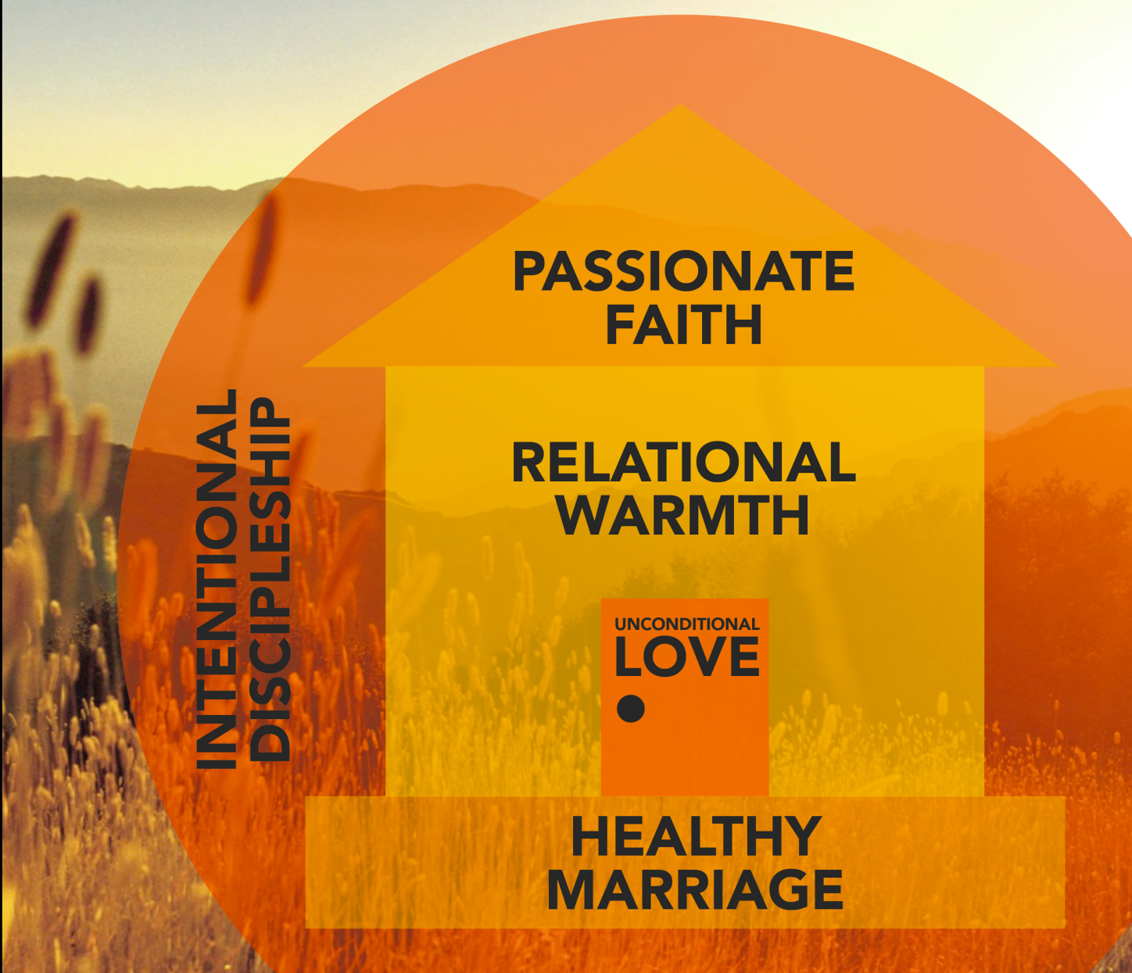
Children, Youth and Family
Discipleship
Real Life Ministries
Five Generational
Multipliers

Slide 14
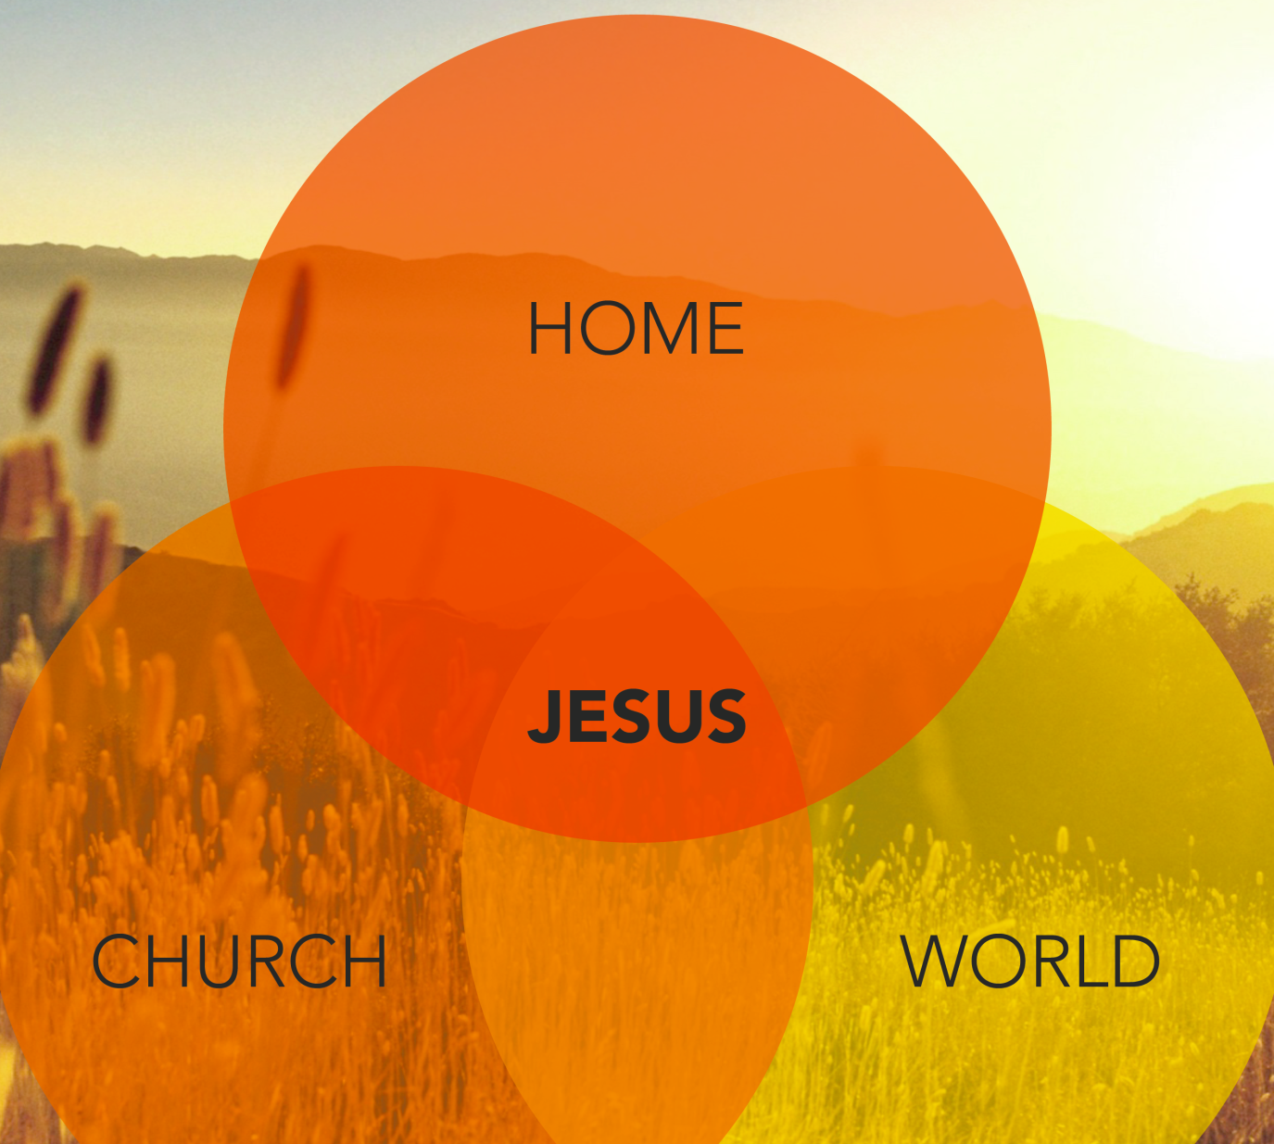
Children, Youth and Family
Discipleship
Real Life Ministries
The Four Relational
Spheres

Slide 15
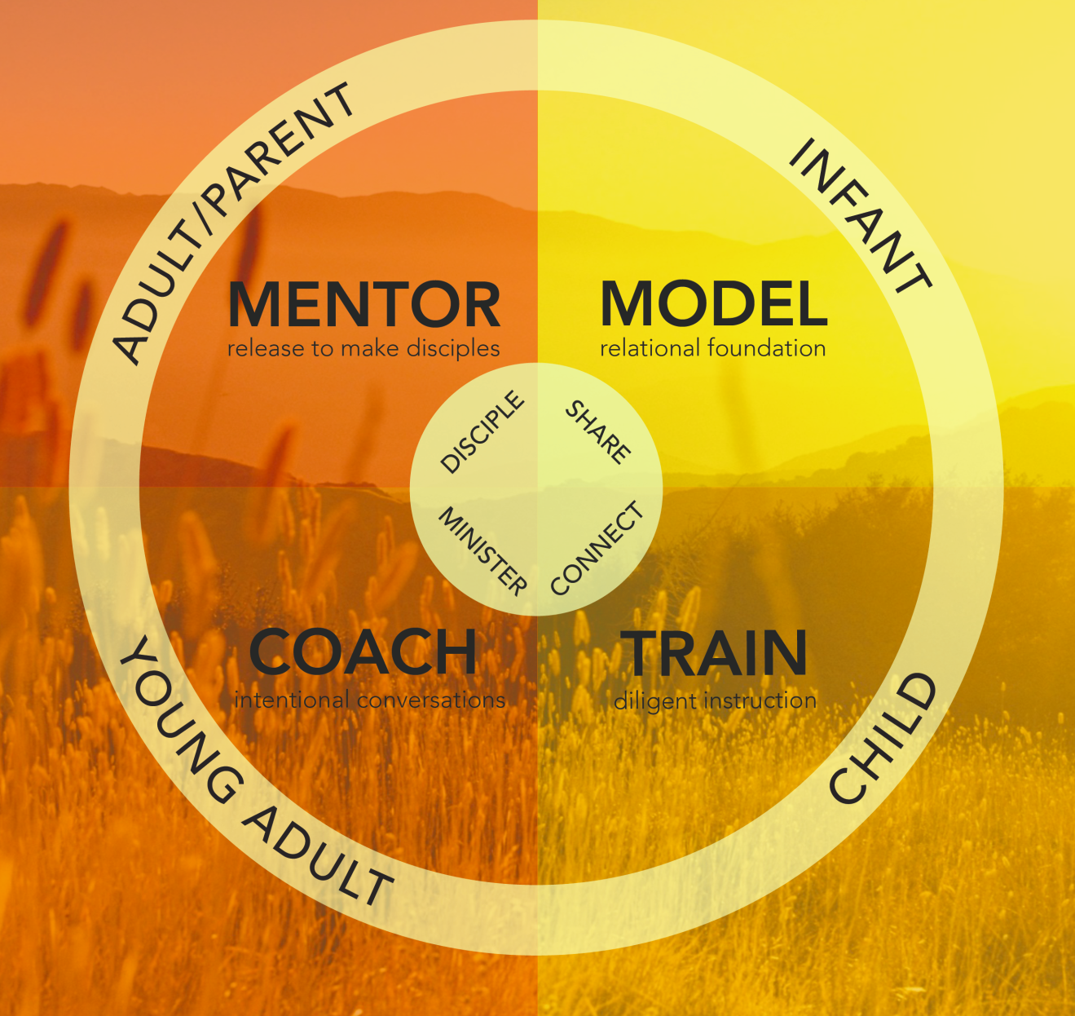
Children, Youth and Family
Discipleship
Real Life Ministries
Effective Home
Discipleship Maintains a
Multi-Generational
Perspective

Slide 16
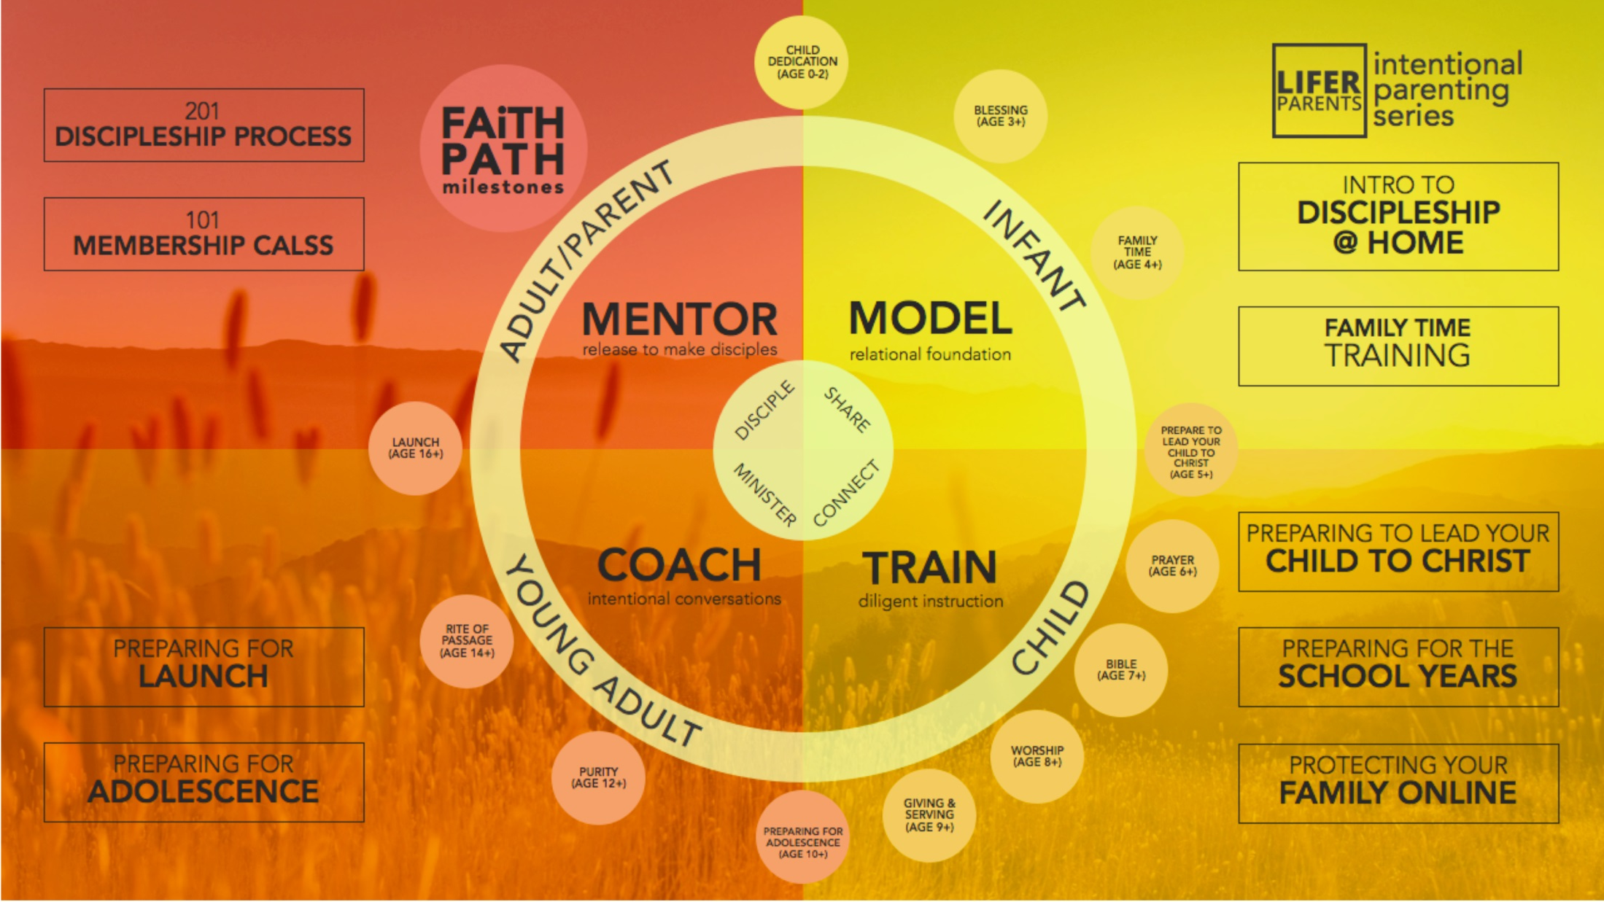

Slide 17
Children, Youth and Family Discipleship
Real Life Ministries
reallifeministries.com
A biblical foundation
An intentional leader
A relational environment
A reproducible process
Alignment

Slide 18
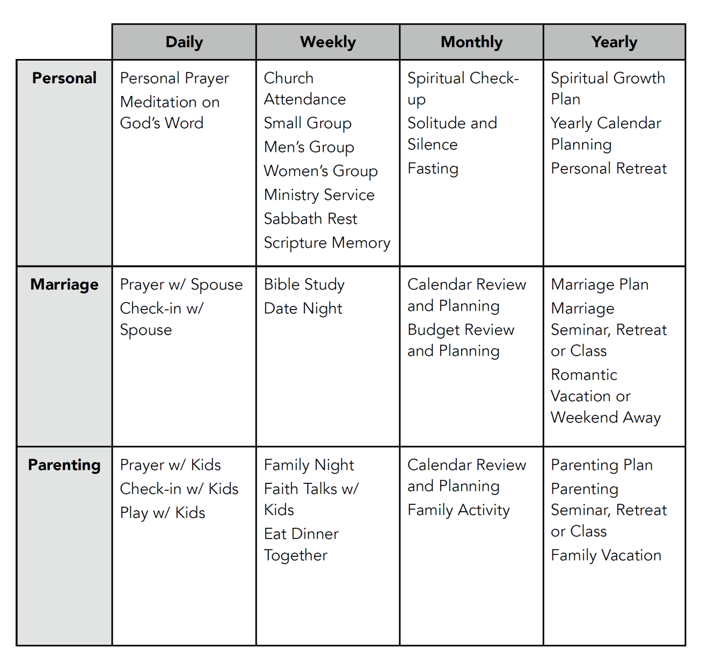
Children, Youth and Family
Discipleship
Real Life Ministries
Alignment Rhythm

Slide 19
Children, Youth and Family Discipleship
Real Life Ministries
reallifeministries.com
A biblical foundation
An intentional leader
A relational environment
A reproducible process
Alignment

