Slide 1



Covenant
Story from Genesis 11-18, 21
06 Covenant // The Story of God for Kids

Slide 2
Review
06 Covenant // The Story of God for Kids

Slide 3
Review
What is the story of Adam and Eve?
06 Covenant // The Story of God for Kids

Slide 4
Review
What is the story of Adam and Eve?
What happened with Cain and Abel?
06 Covenant // The Story of God for Kids

Slide 5
Review
What is the story of Adam and Eve?
What happened with Cain and Abel?
What did we learn about God and people in the story of “The Flood”?
06 Covenant // The Story of God for Kids

Slide 6
Clarify Words
06 Covenant // The Story of God for Kids

Slide 7
Clarify Words
What are descendants or offspring?
06 Covenant // The Story of God for Kids

Slide 8
Clarify Words
What are descendants or offspring?
What are generations?
06 Covenant // The Story of God for Kids

Slide 9
Clarify Words
What are descendants or offspring?
What are generations?
What is an inheritance?
06 Covenant // The Story of God for Kids

Slide 10
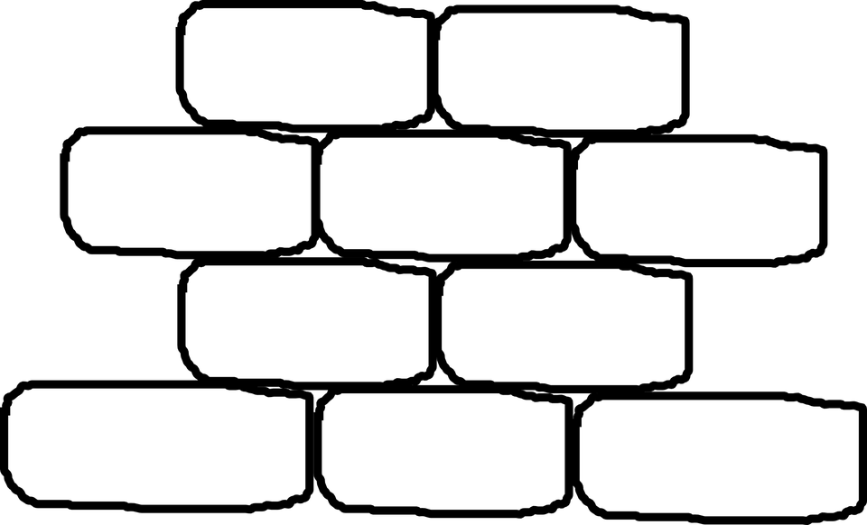
Tower of Babel
06 Covenant // The Story of God for Kids

Slide 11
Tower of Babel
“Now the whole world had one language and a common speech. As men moved eastward, they found a plain in Shinar and settled there.
06 Covenant // The Story of God for Kids

Slide 12
Tower of Babel
“Now the whole world had one language and a common speech. As men moved eastward, they found a plain in Shinar and settled there.
“They said to each other, ‘Come, let’s make bricks and bake them thoroughly.’ They used bricks instead of stone, and tar for mortar.
06 Covenant // The Story of God for Kids

Slide 13
Tower of Babel
“Now the whole world had one language and a common speech. As men moved eastward, they found a plain in Shinar and settled there.
“They said to each other, ‘Come, let’s make bricks and bake them thoroughly.’ They used bricks instead of stone, and tar for mortar.
“Then they said, ‘Come, let us build ourselves a city, with a tower that reaches to the heavens, so that we may make a name for ourselves and not be scattered over the face of the whole earth.’”
06 Covenant // The Story of God for Kids

Slide 14
Tower of Babel
“But the LORD came down to see the city and the tower that the men were building. The LORD said, ‘If as one people speaking the same language they have begun to do this, then nothing they plan to do will be impossible for them. Come, let us go down and confuse their language so they will not understand each other.’
06 Covenant // The Story of God for Kids

Slide 15
Tower of Babel
“But the LORD came down to see the city and the tower that the men were building. The LORD said, ‘If as one people speaking the same language they have begun to do this, then nothing they plan to do will be impossible for them. Come, let us go down and confuse their language so they will not understand each other.’
“So the LORD scattered them from there over all the earth, and they stopped building the city. That is why it was called
Babel—because there the LORD confused the language of the whole world. From there the LORD scattered them over the face of the earth.”
06 Covenant // The Story of God for Kids

Slide 16
Call of Abram
06 Covenant // The Story of God for Kids

Slide 17
Call of Abram
“The LORD had said to Abram, ‘Leave your country, your people and your father’s household and go to the land I will show you.’”
06 Covenant // The Story of God for Kids

Slide 18
Call of Abram
“I will make you into a great nation and I will bless you;
06 Covenant // The Story of God for Kids

Slide 19
Call of Abram
“I will make you into a great nation and I will bless you;
I will make your name great, and you will be a blessing.
06 Covenant // The Story of God for Kids

Slide 20
Call of Abram
“I will make you into a great nation and I will bless you;
I will make your name great, and you will be a blessing.
I will bless those who bless you, and whoever curses you I will curse;
06 Covenant // The Story of God for Kids

Slide 21
Call of Abram
“I will make you into a great nation and I will bless you;
I will make your name great, and you will be a blessing.
I will bless those who bless you, and whoever curses you I will curse; and all peoples on earth will be blessed through you.”
06 Covenant // The Story of God for Kids

Slide 22
Abram: The Father of the Hebrews
The LORD was making a new kind of people who would show the world what it meant to live in God’s ways.
06 Covenant // The Story of God for Kids

Slide 23
Land of Canaan
“The LORD appeared to Abram and said, ‘To your offspring I will give this land.’”
06 Covenant // The Story of God for Kids

Slide 24
Abram’s Problem
06 Covenant // The Story of God for Kids

Slide 25
Abram’s Problem
Abram was about __ years old.
Sarai was about __ years old.
06 Covenant // The Story of God for Kids

Slide 26
Abram’s Problem
Abram was about 75 years old.
Sarai was about __ years old.
06 Covenant // The Story of God for Kids

Slide 27
Abram’s Problem
Abram was about 75 years old.
Sarai was about 65 years old.
06 Covenant // The Story of God for Kids

Slide 28
Abram’s Problem
Abram was about 75 years old.
Sarai was about 65 years old.
“But Abram said, ‘O Sovereign LORD, what can you give me since I remain childless and the one who will inherit my estate is Eliezer of Damascus?’
06 Covenant // The Story of God for Kids

Slide 29
Abram’s Problem
Abram was about 75 years old.
Sarai was about 65 years old.
“But Abram said, ‘O Sovereign LORD, what can you give me since I remain childless and the one who will inherit my estate is Eliezer of Damascus?’
“And Abram said, ‘You have given me no children; so a servant in my household will be my heir.’”
06 Covenant // The Story of God for Kids

Slide 30
Covenant with Abram
06 Covenant // The Story of God for Kids

Slide 31
Covenant with Abram
“Then the word of the LORD came to him: ‘This man will not be your heir, but a son coming from your own body will be your heir.’
06 Covenant // The Story of God for Kids

Slide 32
Covenant with Abram
“Then the word of the LORD came to him: ‘This man will not be your heir, but a son coming from your own body will be your heir.’
“He took him outside and said, ‘Look up at the heavens and count the stars—if indeed you can count them.’ Then he said, ‘So shall your offspring be.’”
06 Covenant // The Story of God for Kids

Slide 33
Abram Believed
06 Covenant // The Story of God for Kids

Slide 34
Abram Believed
“Abram believed the LORD, and he credited it to him as righteousness.”
06 Covenant // The Story of God for Kids

Slide 35
Abram’s Problem
06 Covenant // The Story of God for Kids

Slide 36
Abram’s Problem
“Now Sarai, Abram’s wife, had borne him no children.”
06 Covenant // The Story of God for Kids

Slide 37
Abram’s Problem
“Now Sarai, Abram’s wife, had borne him no children.”
“Sarai his wife took her Egyptian maidservant Hagar and gave her to her husband to be his wife… so Hagar bore Abram a son, and Abram gave the name Ishmael to the son he had borne.”
06 Covenant // The Story of God for Kids

Slide 38
Abram’s Problem
“Now Sarai, Abram’s wife, had borne him no children.”
“Sarai his wife took her Egyptian maidservant Hagar and gave her to her husband to be his wife… so Hagar bore Abram a son, and Abram gave the name Ishmael to the son he had borne.”
“[Sarai] began to despise her mistress [and] mistreated
Hagar.”
06 Covenant // The Story of God for Kids

Slide 39
Abram to Abraham
06 Covenant // The Story of God for Kids

Slide 40
Abram to Abraham
“When Abram was ninety-nine years old, the LORD appeared to him and said, ‘I am God Almighty; walk before me and be blameless. I will confirm my covenant between me and you and will greatly increase your numbers.’”
06 Covenant // The Story of God for Kids

Slide 41
Abram to Abraham
“When Abram was ninety-nine years old, the LORD appeared to him and said, ‘I am God Almighty; walk before me and be blameless. I will confirm my covenant between me and you and will greatly increase your numbers.’”
06 Covenant // The Story of God for Kids

Slide 42
Abram to Abraham
“When Abram was ninety-nine years old, the LORD appeared to him and said, ‘I am God Almighty; walk before me and be blameless. I will confirm my covenant between me and you and will greatly increase your numbers.’”
“Abram fell facedown, and God said to him, ‘As for me, this is my covenant with you: You will be the father of many nations. No longer will you be called Abram; your name will be Abraham, for I have made you a father of many nations. I will make you very fruitful; I will make nations of you, and kings will come from you.’”
06 Covenant // The Story of God for Kids

Slide 43
Abram to Abraham
“When Abram was ninety-nine years old, the LORD appeared to him and said, ‘I am God Almighty; walk before me and be blameless. I will confirm my covenant between me and you and will greatly increase your numbers.’”
“Abram fell facedown, and God said to him, ‘As for me, this is my covenant with you: You will be the father of many nations. No longer will you be called Abram; your name will be Abraham, for I have made you a father of many nations. I will make you very fruitful; I will make nations of you, and kings will come from you.’”
06 Covenant // The Story of God for Kids

Slide 44
Sarai to Sarah
06 Covenant // The Story of God for Kids

Slide 45
Sarai to Sarah
“God also said to Abraham, ‘As for Sarai your wife, you are no longer to call her Sarai; her name will be Sarah. I will bless her and will surely give you a son by her. I will bless her so that she will be the mother of nations; kings of peoples will come from her.’”
06 Covenant // The Story of God for Kids

Slide 46
Abraham and Sarah Laugh
06 Covenant // The Story of God for Kids

Slide 47
Abraham and Sarah Laugh
“Abraham fell facedown; he laughed and said to himself, ‘Will a son be born to a man a hundred years old? Will Sarah bear a child at the age of ninety?’”
06 Covenant // The Story of God for Kids

Slide 48
Abraham and Sarah Laugh
“Abraham fell facedown; he laughed and said to himself, ‘Will a son be born to a man a hundred years old? Will Sarah bear a child at the age of ninety?’”
“So Sarah laughed to herself as she thought, ‘After I am worn out and my master is old, will I now have this pleasure?’”
06 Covenant // The Story of God for Kids

Slide 49
Abraham and Sarah Laugh
“Abraham fell facedown; he laughed and said to himself, ‘Will a son be born to a man a hundred years old? Will Sarah bear a child at the age of ninety?’”
“So Sarah laughed to herself as she thought, ‘After I am worn out and my master is old, will I now have this pleasure?’”
The LORD: “Is anything too hard for the LORD?”
06 Covenant // The Story of God for Kids

Slide 50
Abraham and Sarah Have a Son
06 Covenant // The Story of God for Kids

Slide 51
Abraham and Sarah Have a Son
“Now the LORD was gracious to Sarah as he had said, and the LORD did for Sarah what he had promised. Sarah became pregnant and bore a son to Abraham in his old age, at the very time God had promised him.
06 Covenant // The Story of God for Kids

Slide 52
Abraham and Sarah Have a Son
“Now the LORD was gracious to Sarah as he had said, and the LORD did for Sarah what he had promised. Sarah became pregnant and bore a son to Abraham in his old age, at the very time God had promised him.
“Abraham gave the name Isaac to the son Sarah bore him… Abraham was a hundred years old when his son Isaac was born to him.”
06 Covenant // The Story of God for Kids

Slide 53
Abraham and Sarah Have a Son
“Now the LORD was gracious to Sarah as he had said, and the LORD did for Sarah what he had promised. Sarah became pregnant and bore a son to Abraham in his old age, at the very time God had promised him.
“Abraham gave the name Isaac to the son Sarah bore him… Abraham was a hundred years old when his son Isaac was born to him.”
“Sarah said, ‘God has brought me laughter, and everyone who hears about this will laugh with me.’”
06 Covenant // The Story of God for Kids

Slide 54
Covenant
The birth of Isaac was the beginning of God completing the promise He made to Abraham. God desired for Abraham’s descendants, called the Hebrews, to be a new kind of people who would show the world what it means to live in God’s ways.
06 Covenant // The Story of God for Kids

